Slide 1
From metal ores to financial risk: a macro-evolutionary model of the energy transition with energy, financial and commodity markets
Taras Kryvyy, Karolina Safarzynska
Faculty of Economic Sciences, Warsaw University
Acknowledgments.
We acknowledge financial support from the National Science Centre, Poland, grant no. 2019/35/B/HS4/00140.

Slide 2
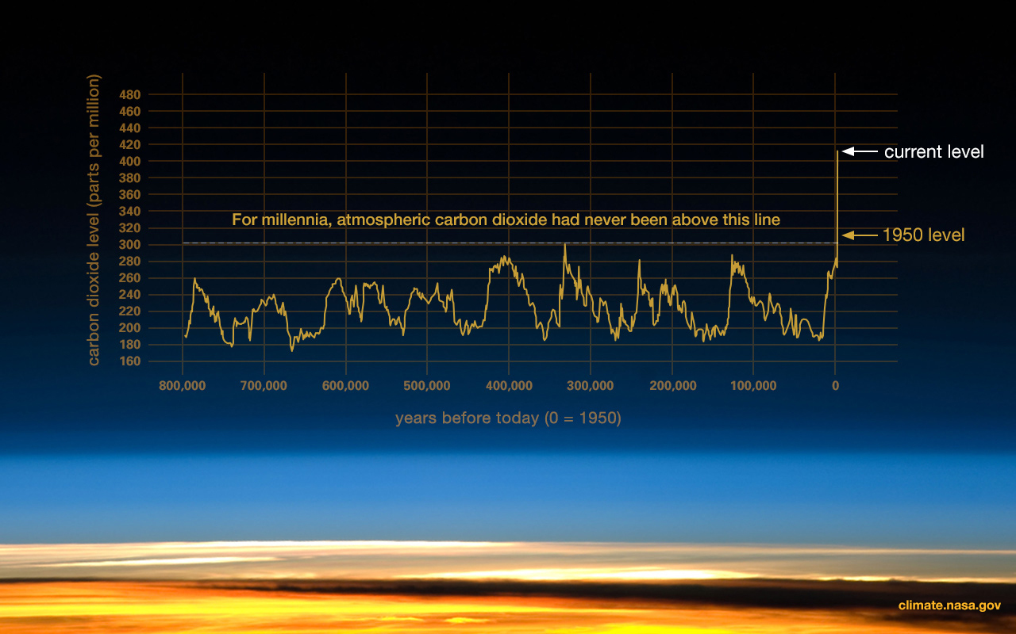
Main motivation
Source: (climate.nasa.gov)

Slide 3
Climate-related macro-financial risks?
Climate-related
Physical (biophysical → socio-economic impacts)
Transition (structural change, financing, stranding)
Macro-financial
Macroeconomic (production, taxation, inflation)
Financial (banks, asset management, insurance)
Macro-financial (money, financial stability, macro-prudential)

Slide 4
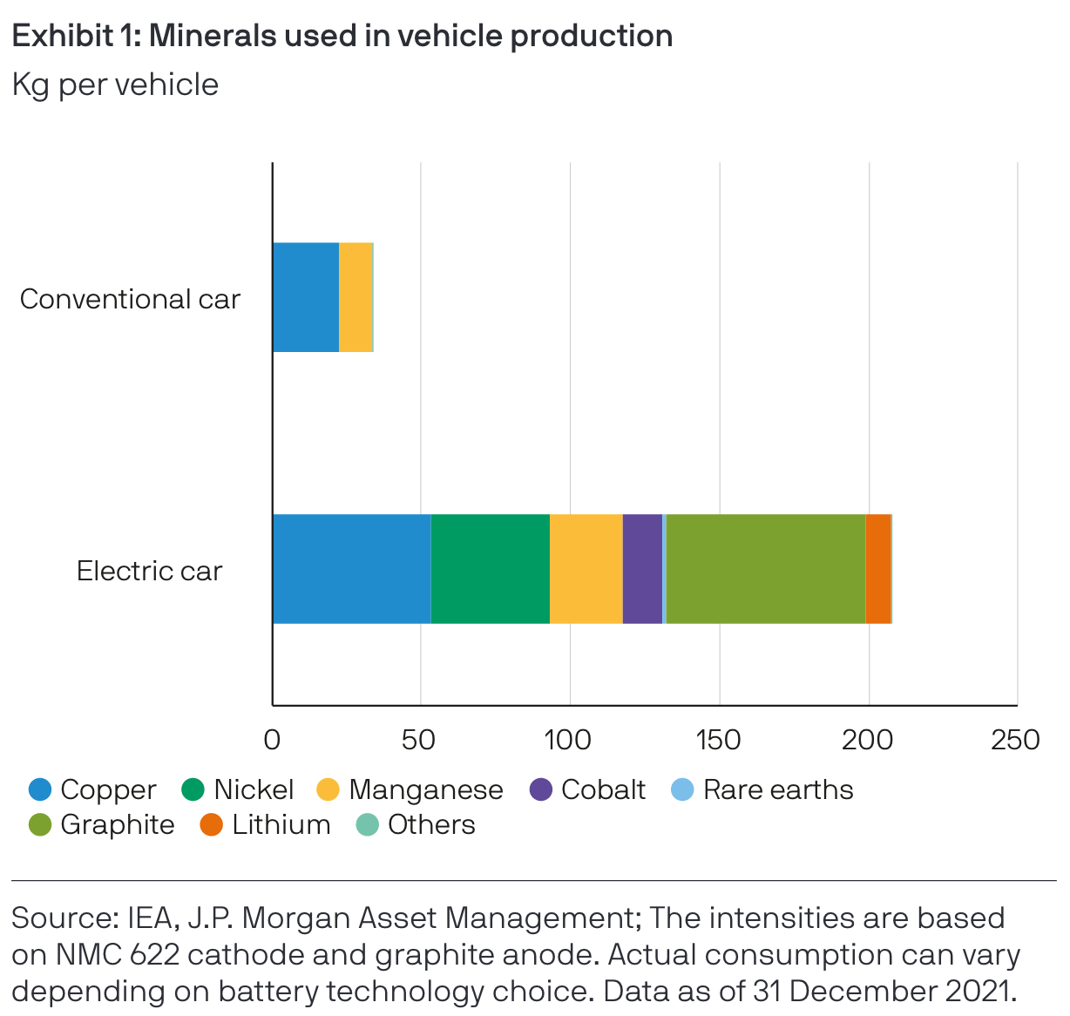
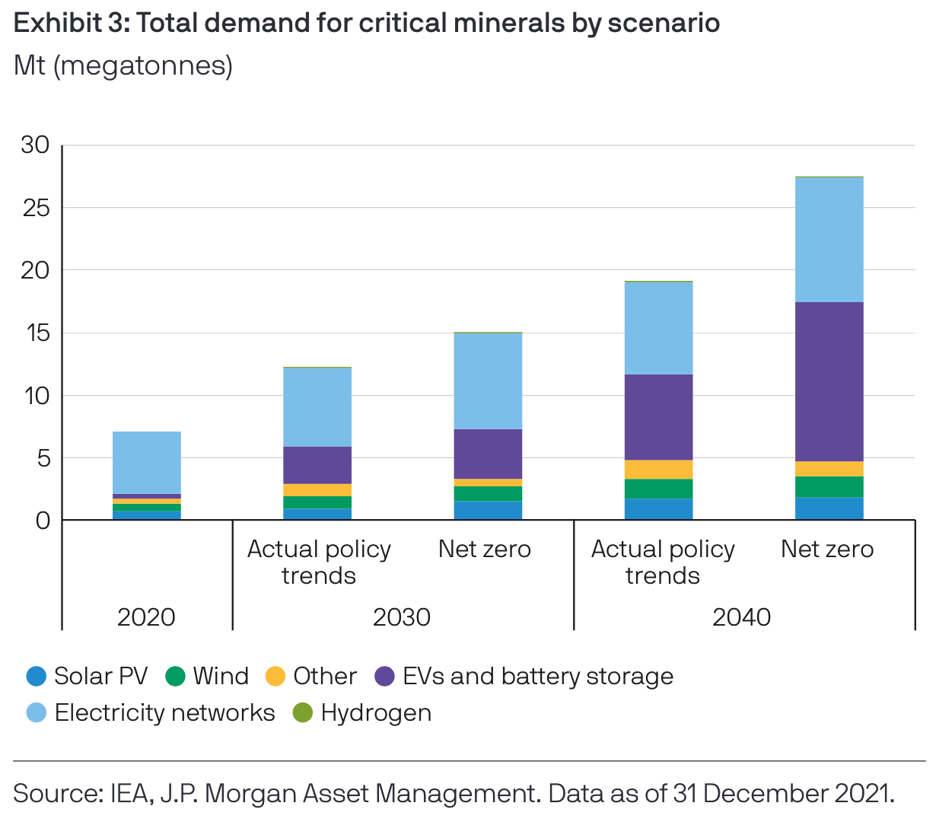
Minerals are critical for the low-carbon transition
Taken from (Galler, 2022)

Slide 5
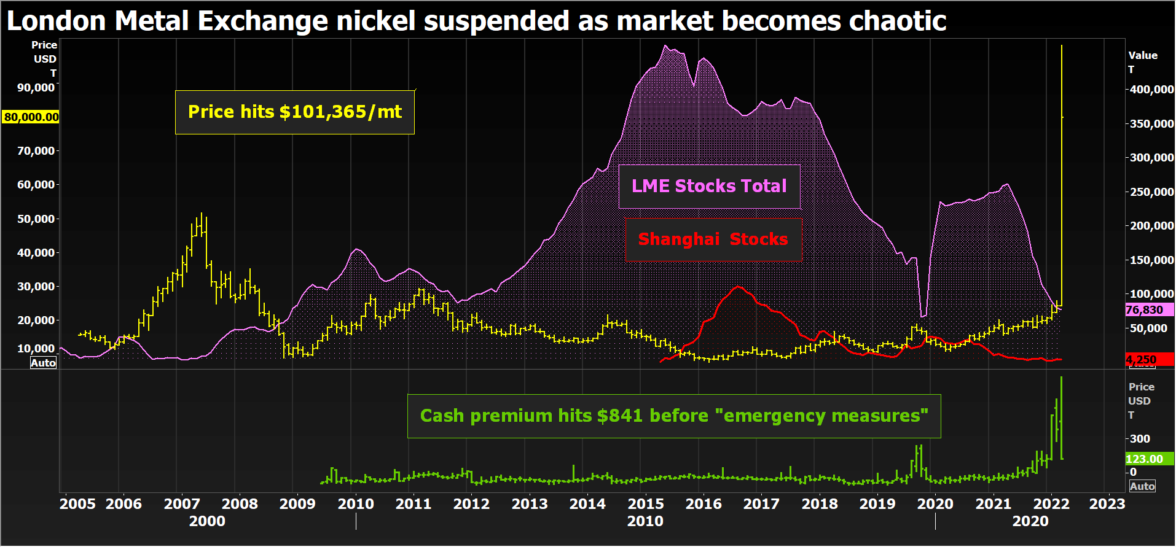
Taken from Reuters
See more in (Financial Stability Board, 2023)

Slide 6
Current discussion
Financial risks associated with the transition to a low-carbon economy (Monasterolo et al., 2018; Stolbova et al., 2018; Semieniuk et al., 2021)
Climate stress testing framework (Battiston et al., 2017)
Climate-related SFC ABMs (Aglietta and Espagne, 2016; Dafermos et al., 2017; Monasterolo et al., 2019; Roncoroni et al., 2021; Safarzynska and van den Bergh, 2017a)
ABMs focusing on shocks propagating through the network of interrelated banks and firms (Tedeschi et al., 2012; Thurner and Poledna, 2013; Poledna and Thurner, 2016)
Metal scarcity in theoretical models (Chazel et al., 2023; Fabre et al., 2020, and Pommeret et al., 2022)
Commodity-related systemic risks (Basher & Sadorsky, 2024; Financial Stability Board, 2023; Ouyang et al., 2024)
…
Role of material intensity of energy transition is underplayed (Safarzynska and Kryvyy, in progress)

Slide 7
Climate-related risks
Financial stability
Commodity markets
?
✓
~
✓

Slide 8
Original research questions
How does (i) demand for raw materials impact (ii) financial markets stability? (and vice versa)
Financial markets stability
Demand for raw materials
Biases and heuristics
Transition to a low-carbon economy
How does investor psychology affect the relationship between (i) and (ii)?
How would the energy transition affect the relationship between (i) and (ii)?
Biases and heuristics

Slide 9
Agents in the model
Multiple final good firms (produces C good)
Continuously replace capital
Multiple power plans that take loans and produce energy (for C firms)
Make capital investment once when entering the market
Have a finite lifespan
Multiple capital good firms (for final good firms, clean power plans, dirty power plants, mining firms)

Slide 10
Agents in the model
Multiple mining sites that contain heterogenous ore deposits
Multiple mining firms that produce minerals used by all capital good firms
Continuously replace capital
A single bank (grants loans with certain probability)
Multiple households (receives wages and dividends, provides labor)
Government (pays unemployment benefit as a fraction of wage)

Slide 11
Model structure: flow of goods
Households
All productive firms:
Final good sector
Capital sectors for:
- material
Material sector
Final good sector
Power Plants:
- ores
- final good
Renewable Energy sector
Renewable Energy sector
Material sector
- capital
- fuel
Fossil-fuel Energy sector
Fossil-fuel Energy sector
- electricity
- labor
Mining sites
Foreign economy

Slide 12
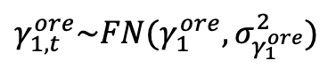
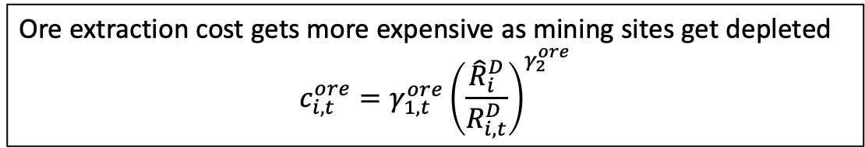
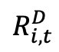
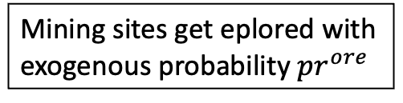
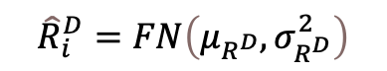
Ore extraction
Ore extraction cost gets more expensive as mining sites get depleted
$$c_{i,t}^{ore}=γ_{1,t}^{ore}{\left(\frac{{\hat{R}}_{i}^{D}}{R_{i,t}^{D}}\right)}^{γ_{2}^{ore}}$$
Households
Mining sites get eplored with exogenous probability $pr^{ore}$
All productive firms:
Final good sector
$γ_{1,t}^{ore}\sim FN(γ_{1}^{ore},σ_{γ_{1}^{ore}}^{2})$
$${\hat{R}}_{i}^{D}=FN\left(μ_{R^{D}},σ_{R^{D}}^{2}\right)$$
Capital sectors for:
- material
Material sector
Final good sector
Power Plants:
- ores
- final good
Renewable Energy sector
Renewable Energy sector
Material sector
- capital
- fuel
Fossil-fuel Energy sector
Fossil-fuel Energy sector
- electricity
$$R_{i,t}^{D}$$
- labor
Mining sites
Foreign economy
Mining sites get abandoned when extraction costs get too expensive

Slide 13
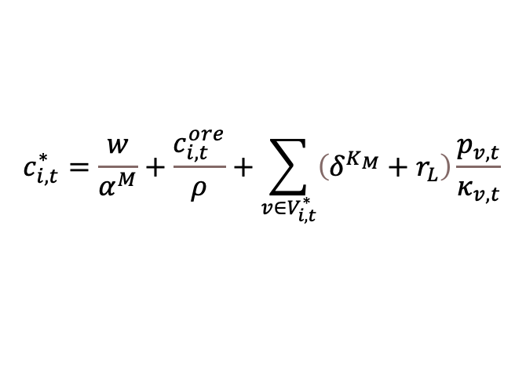
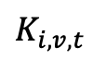
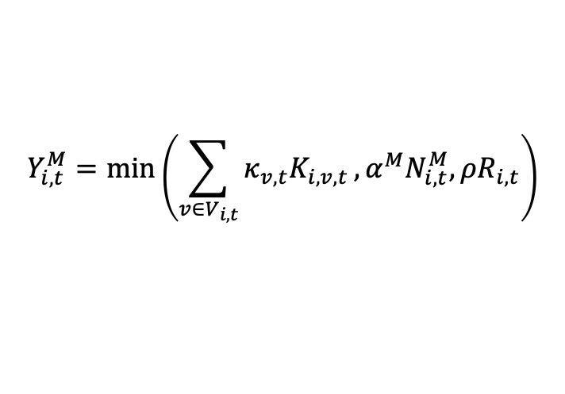
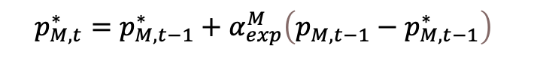
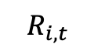
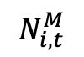
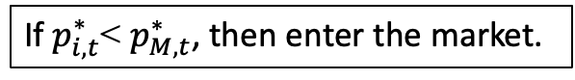
Processing ore into materials
$$Y_{i,t}^{M}=min\left(\sum_{v∈V_{i,t}}^{​}{κ_{v,t}K_{i,v,t}},α^{M}N_{i,t}^{M},ρR_{i,t}\right)$$
Households
Entry dynamics:
$$N_{i,t}^{M}$$
$$c_{i,t}^{∗}=\frac{w}{α^{M}}+\frac{c_{i,t}^{ore}}{ρ}+\sum_{v∈V_{i,t}^{∗}}{\left(δ^{K_{M}}+r_{L}\right)\frac{p_{v,t}}{κ_{v,t}}}$$
All productive firms:
Final good sector
$p_{i,t}^{∗}=\left(1+μ_{M,0}\right)c_{i,t}^{∗}$
Capital sectors for:
- material
$$K_{i,v,t}$$
Material sector
Final good sector
Power Plants:
- ores
- final good
Renewable Energy sector
Renewable Energy sector
Material sector
- capital
- fuel
Fossil-fuel Energy sector
Fossil-fuel Energy sector
- electricity
$$R_{i,t}$$
- labor
Mining sites
Foreign economy
$$\begin{aligned}&p_{M,t}^{∗}=p_{M,t−1}^{∗}+α_{exp}^{M}\left(p_{M,t−1}−p_{M,t−1}^{∗}\right) \end{aligned}$$
If $p_{i,t}^{∗}$< $p_{M,t}^{∗}$, then enter the market.

Slide 14
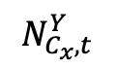

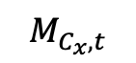
Production of sector-specific capital goods
Households
$$Y_{C_{x},t}=min\left(α_{C_{x},t}N_{C_{x},t}^{Y},m^{C_{x}}M_{C_{x},t}\right)$$
$$N_{C_{x},t}^{Y}$$
R&D based on Dosi et al., (2010) and Terranova & Turco, (2022)
All productive firms:
Final good sector
Capital sectors for:
$$M_{C_{x},t}$$
- material
Material sector
Final good sector
Power Plants:
- ores
- final good
Renewable Energy sector
Renewable Energy sector
Material sector
- capital
- fuel
Fossil-fuel Energy sector
Fossil-fuel Energy sector
- electricity
- labor
$$\begin{aligned}RD_{i,t+1}=νπ_{i,t}^{net}\end{aligned}$$
$$\begin{aligned}{IN}_{i,t+1}=\left(1−χ\right)⋅RD_{i,t+1}\end{aligned}$$
$$\begin{aligned}{IM}_{i,t+1}=χ⋅RD_{i,t+1}\#\end{aligned}$$
Mining sites
Foreign economy

Slide 15
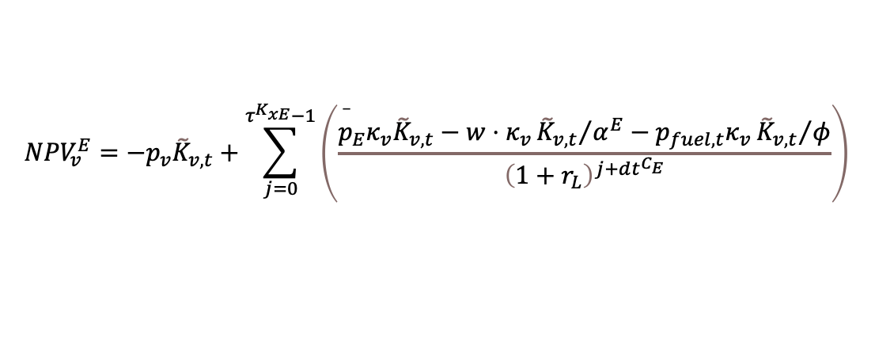
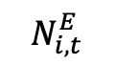
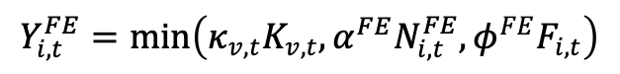
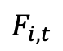
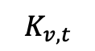
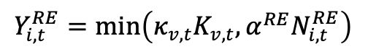
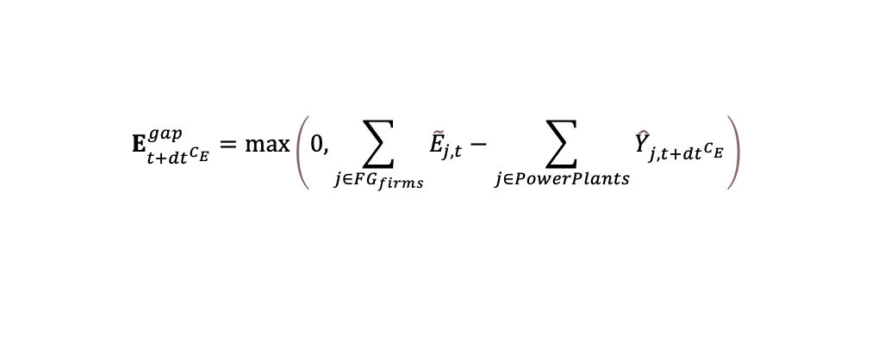
Electricity generation
Two types of technology compete:
$${NPV}_{v}^{E}=−p_{v}{\tilde{K}}_{v,t}+\sum_{j=0}^{τ^{K_{xE}}−1}{\left(\frac{{\overset{‾}{p}}_{E}κ_{v}{\tilde{K}}_{v,t}−w⋅κ_{v}{{\tilde{K}}_{v,t}}/{α^{E}}−p_{fuel,t}κ_{v}{{\tilde{K}}_{v,t}}/φ}{{\left(1+r_{L}\right)}^{j+dt^{C_{E}}}}\right)}$$
Households
$$N_{i,t}^{E}$$
$$Y_{i,t}^{RE}=min\left(κ_{v,t}K_{v,t},α^{RE}N_{i,t}^{RE}\right)$$
All productive firms:
Final good sector
$$Y_{i,t}^{FE}=min\left(κ_{v,t}K_{v,t},α^{FE}N_{i,t}^{FE},φ^{FE}F_{i,t}\right)$$
Capital sectors for:
- material
Material sector
Final good sector
Power Plants:
- ores
- final good
Renewable Energy sector
Renewable Energy sector
Material sector
- capital
$$K_{v,t}$$
- fuel
Fossil-fuel Energy sector
Fossil-fuel Energy sector
- electricity
- labor
Mining sites
Foreign economy
Power plants have finite lifespan.
$$F_{i,t}$$
$$E_{t+{dt}^{C_{E}}}^{gap}=max\left(0,\sum_{j∈FG_{firms}}{{\tilde{E}}_{j,t}}−\sum_{j∈PowerPlants}{{\hat{Y}}_{j,t+{dt}^{C_{E}}}}\right)$$
$$dp_{fuel,t}=μ_{fuel}p_{fuel,t}dt+σ_{fuel}p_{fuel,t}dW_{t}$$

Slide 16
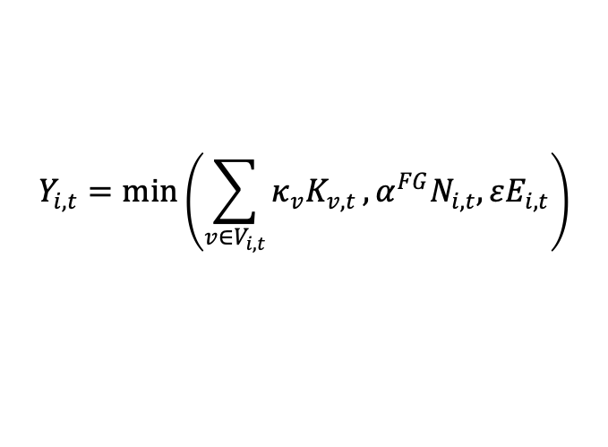
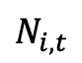
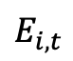
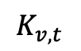
Final good production and consumption
Households
$$N_{i,t}$$
$$Y_{i,t}=min\left(\sum_{v∈V_{i,t}}^{​}{κ_{v}K_{v,t}},α^{FG}N_{i,t},εE_{i,t}\right)$$
All productive firms:
Final good sector
$$E_{i,t}$$
Capital sectors for:
$$K_{v,t}$$
- material
Material sector
Final good sector
Power Plants:
- ores
- final good
Renewable Energy sector
Renewable Energy sector
Material sector
- capital
- fuel
Fossil-fuel Energy sector
Fossil-fuel Energy sector
- electricity
- labor
Mining sites
Foreign economy
$$C_{h,t}=c_{Y}^{HH}\left(Y_{h,t}+div_{h,t}\right)+c_{D}^{HH}D_{j,t}$$

Slide 17
Government
Taxpayers & Deposit holders:
Households
Dividend payers:
All productive firms:
Final good sector
Capital sectors for:
- taxes
Material sector
Final good sector
Power Plants:
- unempl. benefit
- dividends
Renewable Energy sector
Renewable Energy sector
Material sector
- loans
- interest on loans
Fossil-fuel Energy sector
Fossil-fuel Energy sector
Commercial bank
- deposits
- interest on deposits
- payment for goods and services
Mining sites
Foreign economy

Slide 18
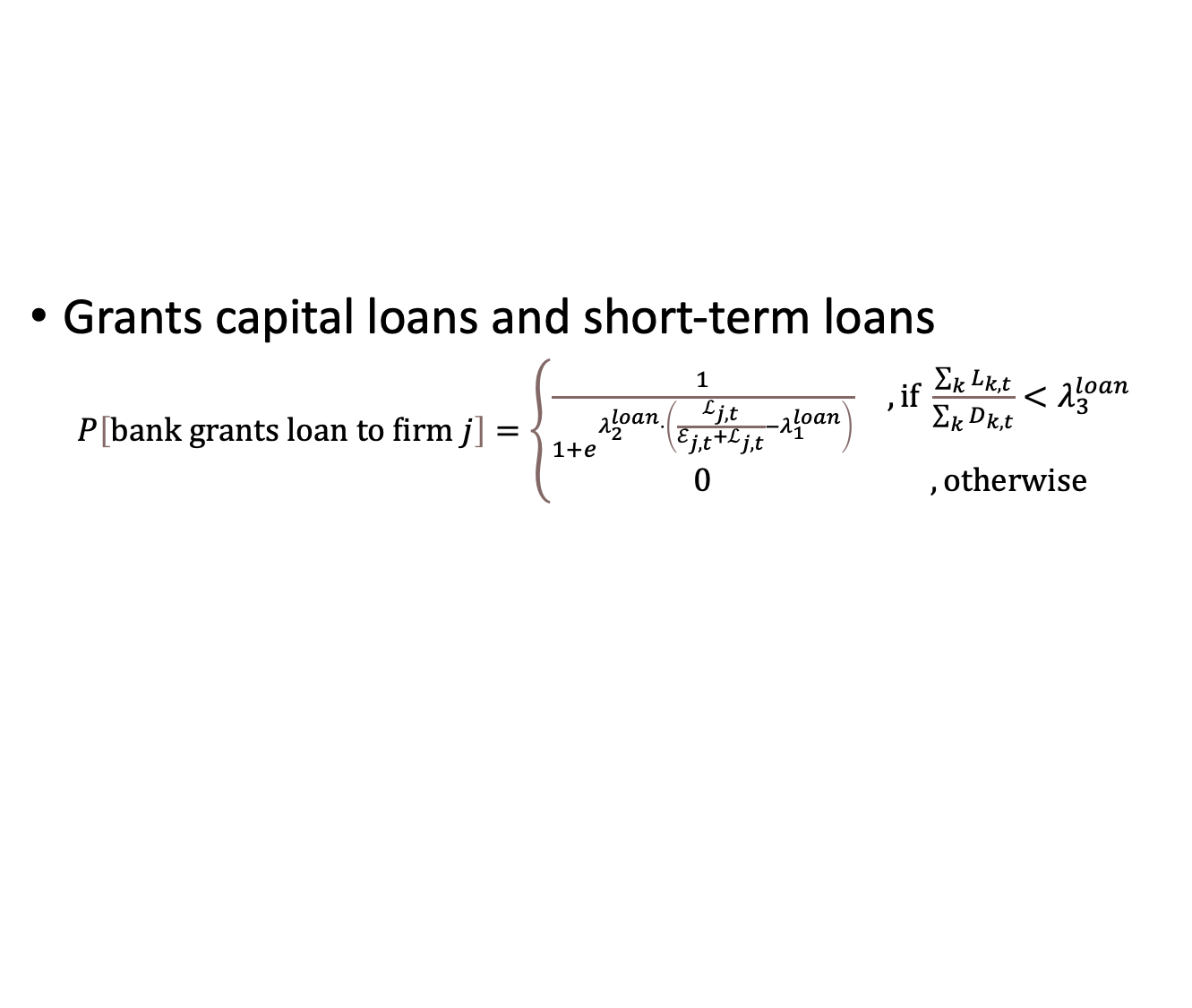
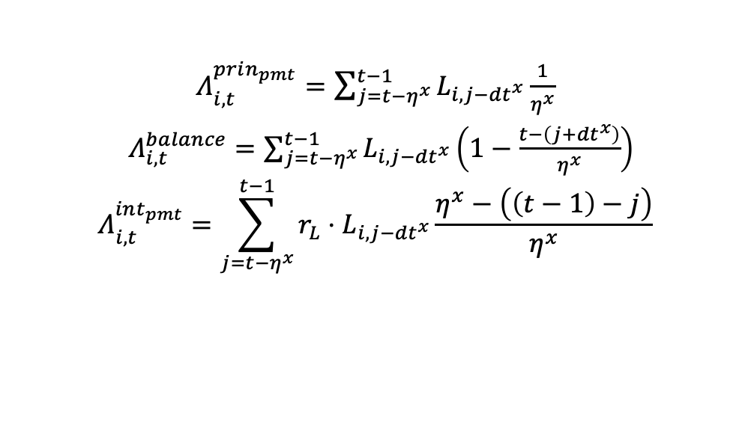
Commercial Bank
Grants capital loans and short-term loans
$P\left[bank grants loan to firm j\right]=\left\{\begin{matrix}\frac{1}{1+e^{λ_{2}^{loan}⋅\left(\frac{ℒ_{j,t}}{ℰ_{j,t}+ℒ_{j,t}}−λ_{1}^{loan}\right)}} & ,if \frac{\sum_{k}{L_{k,t}}}{\sum_{k}{D_{k,t}}}<λ_{3}^{loan} \\ 0 & ,otherwise\end{matrix}\right.$
$Λ_{i,t}^{prin_{pmt}}=\sum_{j=t−η^{x}}^{t−1}{L_{i,j−{dt}^{x}}\frac{1}{η^{x}}}$
$Λ_{i,t}^{balance}=\sum_{j=t−η^{x}}^{t−1}{L_{i,j−{dt}^{x}}}\left(1−\frac{t−\left(j+{dt}^{x}\right)}{η^{x}}\right)$
$$Λ_{i,t}^{int_{pmt}}=\sum_{j=t−η^{x}}^{t−1}{r_{L}⋅L_{i,j−{dt}^{x}}\frac{η^{x}−\left(\left(t−1\right)−j\right)}{η^{x}}}$$

Slide 19
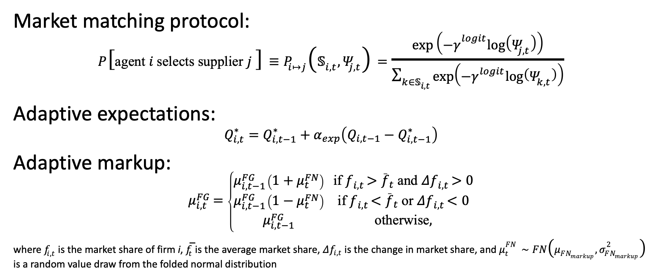
Other details
Market matching protocol:
$$\begin{matrix}P\left[\text{agent} i \text{selects} \text{supplier} j \right]≡P_{i↦j}\left(𝕊_{i,t},Ψ_{j,t}\right)=\frac{exp\left(−γ^{logit}log\left(Ψ_{j,t}\right)\right)}{\sum_{k∈𝕊_{i,t}}^{​}{exp\left(−γ^{logit}log\left(Ψ_{k,t}\right)\right)}} \\ \end{matrix}$$
Adaptive expectations:
$$Q_{i,t}^{∗}=Q_{i,t−1}^{∗}+α_{exp}\left(Q_{i,t−1}−Q_{i,t−1}^{∗}\right)$$
Adaptive markup:
$$μ_{i,t}^{FG}=\left\{\begin{matrix}μ_{i,t−1}^{FG}\left(1+μ_{t}^{FN}\right) & \text{if} f_{i,t}>{\overset{‾}{f}}_{t} \text{and} Δf_{i,t}>0 \\ μ_{i,t−1}^{FG}\left(1−μ_{t}^{FN}\right) & \text{if} f_{i,t}<{\overset{‾}{f}}_{t} \text{or} Δf_{i,t}<0 \\ μ_{i,t−1}^{FG} & \text{otherwise},\end{matrix}\right.$$
where $f_{i,t}$ is the market share of firm i, ${\overset{‾}{f}}_{t}$ is the average market share, $Δf_{i,t}$ is the change in market share, and $μ_{t}^{FN}∼FN\left(μ_{FN_{markup}},σ_{FN_{markup}}^{2}\right)$ is a random value draw from the folded normal distribution

Slide 20
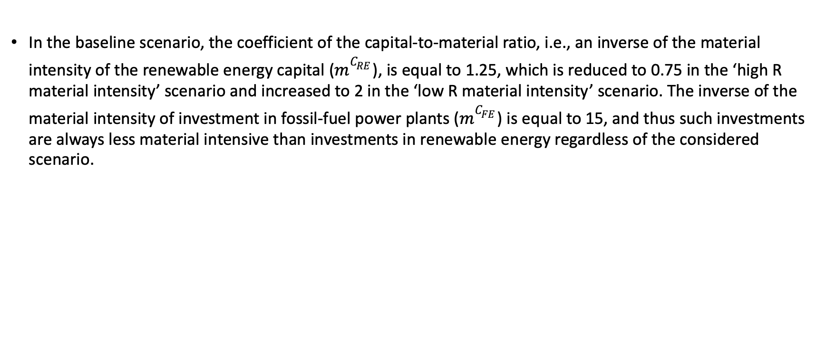
Effect of the relative material intensity of investments in renewable power plants to fossil-fuel power plants
In the baseline scenario, the coefficient of the capital-to-material ratio, i.e., an inverse of the material intensity of the renewable energy capital ($m^{C_{RE}}$), is equal to 1.25, which is reduced to 0.75 in the ‘high R material intensity’ scenario and increased to 2 in the ‘low R material intensity’ scenario. The inverse of the material intensity of investment in fossil-fuel power plants ($m^{C_{FE}}$) is equal to 15, and thus such investments are always less material intensive than investments in renewable energy regardless of the considered scenario.

Slide 21
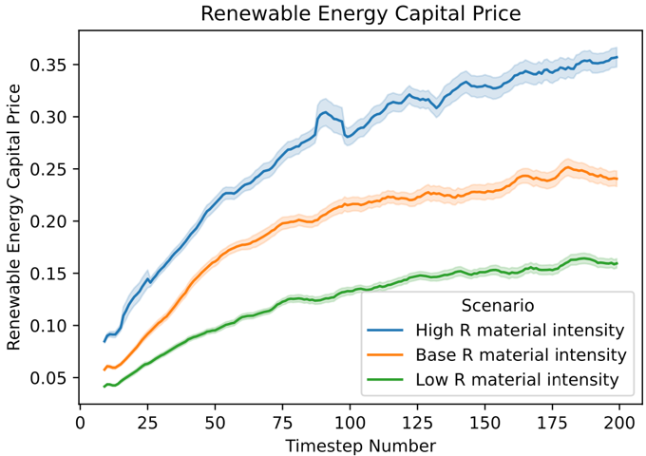
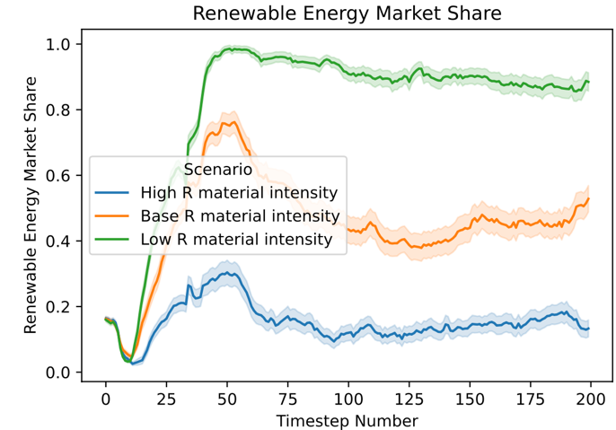
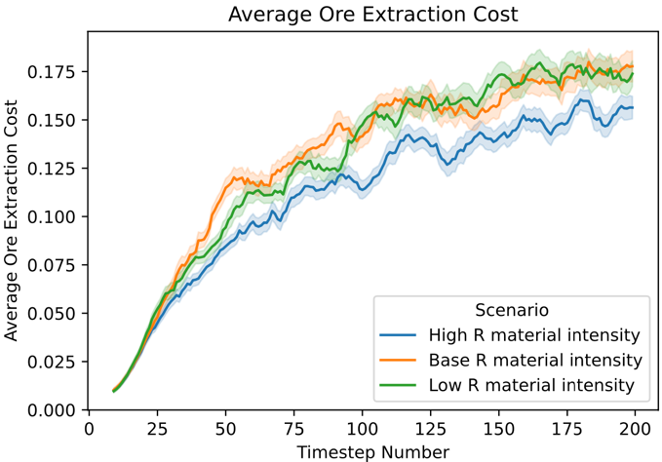
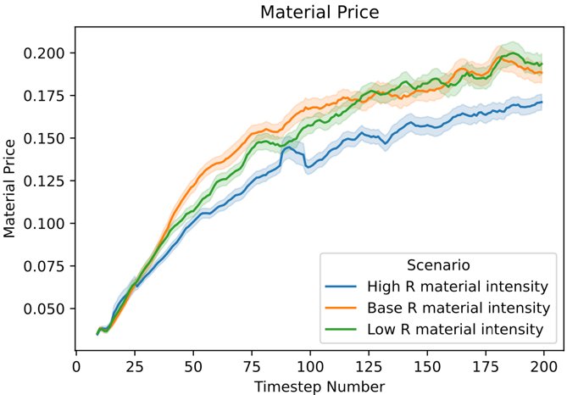
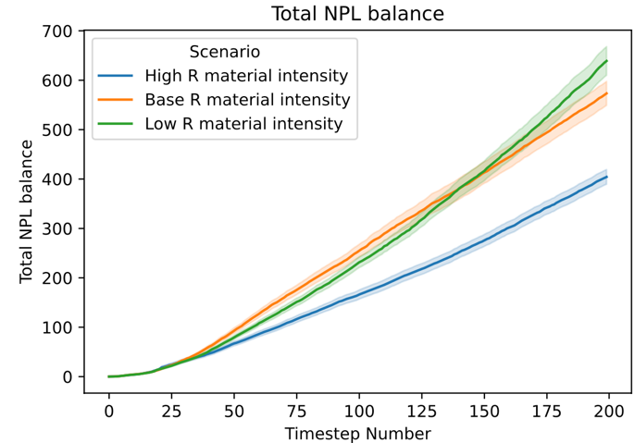
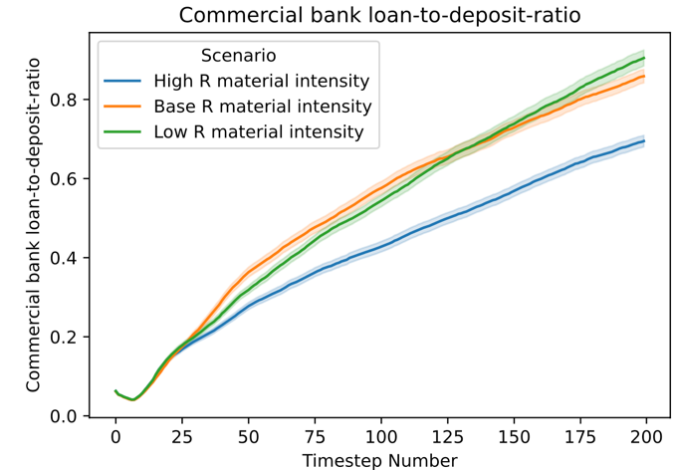
Effect of the relative material intensity of investments in renewable power plants to fossil-fuel power plants (1)

Slide 22
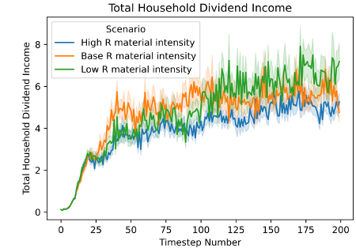
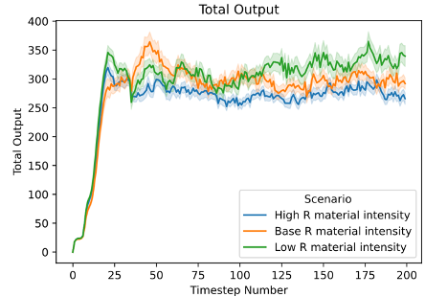
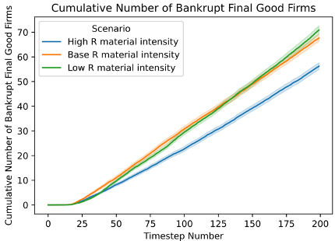
Effect of the relative material intensity of investments in renewable power plants to fossil-fuel power plants (2)

Slide 23
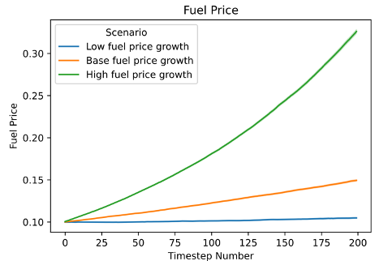
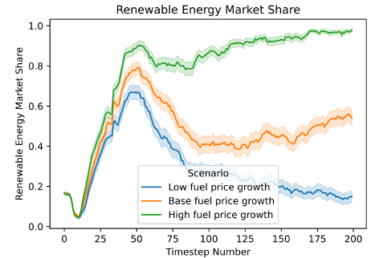
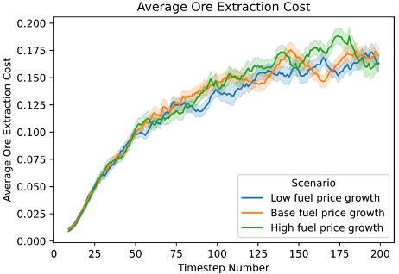
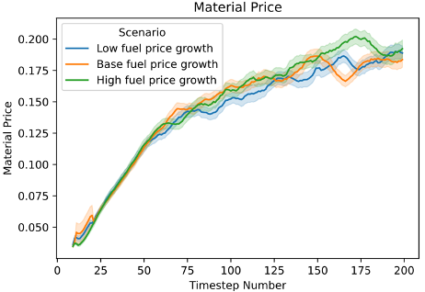
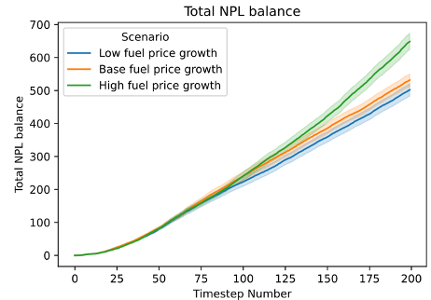
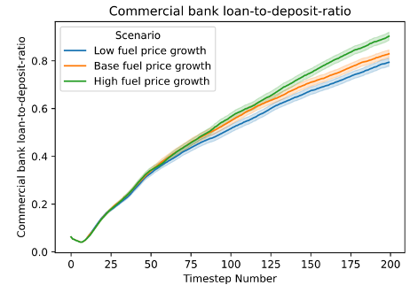
Effect of the dynamics of fuel prices on the low-carbon transition (1)

Slide 24
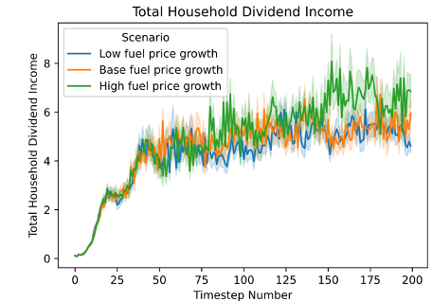
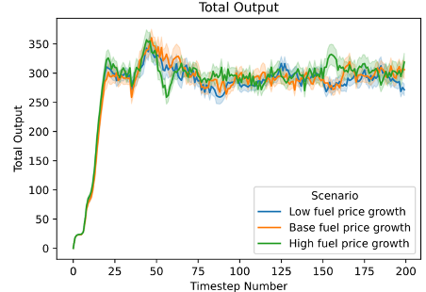

Effect of the dynamics of fuel prices on the low-carbon transition (2)

Slide 25






Effect of the declining metal ore extraction costs (1)

Slide 26



Effect of the declining metal ore extraction costs (2)

Slide 27






Effect of the geopolitical risk (1)

Slide 28



Effect of the geopolitical risk (2)

Slide 29

Effect of the geopolitical risk (3)

Slide 30

Parameter and baseline value | Value | Renewable Energy market share | Average ore extraction cost | Cumulative number of bankruptcies | Total NPL balance | Commercial bank loan-to-deposit-ratio
Mining Site Exploration Probability $$pr^{ore}=0.5$$ | 0.1 | 0.08 (0.02) | 0.29 (0.01) | 69.32 (1.62) | 497.51 (21.59) | 0.82 (0.02)
 | 0.25 | 0.22 (0.02) | 0.23 (0.01) | 80.17 (1.61) | 504.12 (23.05) | 0.82 (0.02)
 | 0.5 | 0.49 (0.03) | 0.17 (0.004) | 88.64 (1.79) | 470.58 (21.10) | 0.77 (0.02)
 | 0.9 | 0.78 (0.02) | 0.12 (0.004) | 88.42 (1.9) | 444.94 (49.97) | 0.71 (0.02)
Average Ore Extraction Cost of a New Mine $$γ_{1}^{ore}=0.3$$ | 0.1 | 0.93 (0.02) | 0.09 (0.002) | 73.94 (1.55) | 287.31 (9.70) | 0.58 (0.01)
 | 0.3 | 0.49 (0.03) | 0.17 (0.004) | 88.64 (1.79) | 470.58 (21.10) | 0.77 (0.02)
 | 0.5 | 0.07 (0.01) | 0.39 (0.01) | 92.47 (1.94) | 1086.06 (64.38) | 1.12 (0.02)
Variance in Initial Ore Extraction Cost $$σ_{γ_{1}^{ore}}^{2}=0.05$$ | 0.005 | 0.003 (0.002) | 0.37 (0.004) | 69.32 (1.49) | 757.13 (35.12) | 0.97 (0.02)
 | 0.05 | 0.49 (0.03) | 0.17 (0.004) | 88.64 (1.79) | 470.58 (21.10) | 0.77 (0.02)
 | 0.03 | 0.29 (0.03) | 0.20 (0.01) | 86.86 (1.82) | 521.95 (24.12) | 0.83 (0.02)

Slide 31

Parameter and baseline value | Value | Renewable Energy market share | Average ore extraction cost | Cumulative number of bankruptcies | Total NPL balance | Commercial bank loan-to-deposit-ratio
Speed of Ore Cost Growth as Ore Deposit Gets Depleted $$γ_{2}^{ore}=0.5$$ | 0.1 | 0.82 (0.02) | 0.12 (0.003) | 70.93 (1.52) | 316.58 (9.80) | 0.61 (0.01)
 | 0.5 | 0.49 (0.03) | 0.17 (0.004) | 88.64 (1.79) | 470.58 (21.10) | 0.77 (0.02)
 | 0.9 | 0.14 (0.02) | 0.41 (0.02) | 116.85 (2.11) | 2759.69 (427.14) | 1.36 (0.03)
Material Productivity of Renewable Energy Capital $$m^{C_{RE}}=1.25$$ | 0.9 | 0.26 (0.03) | 0.16 (0.004) | 80.76 (1.86) | 410.94 (21.97) | 0.71 (0.02)
 | 1.25 | 0.49 (0.03) | 0.17 (0.004) | 88.64 (1.79) | 470.58 (21.10) | 0.77 (0.02)
 | 2 | 0.84 (0.02) | 0.19 (0.01) | 91.07 (1.78) | 548.18 (27.21) | 0.84 (0.02)
Material Productivity of Final Good Capital $$m^{C_{FG}}=1$$ | 0.9 | 0.43 (0.03) | 0.19 (0.01) | 90.88 (2.2) | 599.77 (46.40) | 0.85 (0.02)
 | 1 | 0.49 (0.03) | 0.17 (0.004) | 88.64 (1.79) | 470.58 (21.10) | 0.77 (0.02)
 | 2 | 0.86 (0.02) | 0.11 (0.003) | 57.04 (1.48) | 200.39 (7.20) | 0.45 (0.01)

Slide 32

Parameter and baseline value | Value | Renewable Energy market share | Average ore extraction cost | Cumulative number of bankruptcies | Total NPL balance | Commercial bank loan-to-deposit-ratio
Useful Lifespan of Capital for Renewable Energy Sector $$τ^{C_{RE}}=20$$ | 15 | 0.03 (0.01) | 0.15 (0.004) | 74.95 (1.82) | 346.3 (20.10) | 0.63 (0.02)
 | 20 | 0.49 (0.03) | 0.17 (0.004) | 88.64 (1.79) | 470.58 (21.10) | 0.77 (0.02)
 | 25 | 0.84 (0.02) | 0.18 (0.004) | 91.69 (1.9) | 610.7 (33.86) | 0.88 (0.02)
Ore Productivity $$ρ=1$$ | 0.75 | 0.13 (0.02) | 0.21 (0.01) | 100.74 (1.95) | 771.41 (45.32) | 0.97 (0.02)
 | 1 | 0.49 (0.03) | 0.17 (0.004) | 88.64 (1.79) | 470.58 (21.10) | 0.77 (0.02)
 | 1.25 | 0.81 (0.02) | 0.15 (0.003) | 74.11 (1.53) | 327.74 (10.67) | 0.63 (0.01)
Average Initial Ore Deposit of a New Mine $$μ_{R^{D}}=150$$ | 100 | 0.22 (0.02) | 0.21 (0.01) | 95.2 (1.87) | 547.05 (23.24) | 0.82 (0.02)
 | 150 | 0.49 (0.03) | 0.17 (0.004) | 88.64 (1.79) | 470.58 (21.1) | 0.77 (0.02)
 | 200 | 0.66 (0.03) | 0.14 (0.003) | 76.34 (1.67) | 379.8 (13.29) | 0.70 (0.02)

Slide 33

Parameter and baseline value | Value | Renewable Energy market share | Average ore extraction cost | Cumulative number of bankruptcies | Total NPL balance | Commercial bank loan-to-deposit-ratio
Variance in Amount of Ore in a New Mine $$σ_{R^{D}}^{2}=400$$ | 400 | 0.49 (0.03) | 0.17 (0.004) | 88.64 (1.79) | 470.58 (21.10) | 0.77 (0.02)
 | 8000 | 0.52 (0.03) | 0.17 (0.004) | 82.95 (1.63) | 432.23 (15.86) | 0.75 (0.02)
 | 16000 | 0.55 (0.03) | 0.16 (0.004) | 82.65 (1.52) | 448.79 (20.51) | 0.75 (0.02)
Adaptive Expectation of Material Price $$α_{exp}^{M}=0.5$$ | 0.1 | 0.43 (0.03) | 0.19 (0.004) | 64.69 (1.39) | 523.12 (22.24) | 0.87 (0.02)
 | 0.5 | 0.49 (0.03) | 0.17 (0.004) | 88.64 (1.79) | 470.58 (21.10) | 0.77 (0.02)
 | 0.9 | 0.55 (0.03) | 0.16 (0.003) | 114.70 (1.95) | 417.58 (15.21) | 0.71 (0.01)
Logit Competition Parameter When Picking Mining Site $$γ_{mining}^{logit}=10$$ | 0.01 | 0.20 (0.02) | 0.32 (0.01) | 118.66 (1.66) | 2234.07 (190.07) | 1.4 (0.03)
 | 10 | 0.49 (0.03) | 0.17 (0.004) | 88.64 (1.79) | 470.58 (21.1) | 0.77 (0.02)
 | 50 | 0.48 (0.03) | 0.17 (0.004) | 79.29 (1.86) | 426.95 (17.71) | 0.74 (0.02)

Slide 34

Parameter and baseline value | Value | Renewable Energy market share | Average ore extraction cost | Cumulative number of bankruptcies | Total NPL balance | Commercial bank loan-to-deposit-ratio
Fuel Price Drift $$μ_{fuel}=0.002$$ | 0.0003 | 0.17 (0.02) | 0.16 (0.003) | 82.92 (1.75) | 417.74 (15.92) | 0.73 (0.02)
 | 0.002 | 0.49 (0.03) | 0.17 (0.004) | 88.64 (1.79) | 470.58 (21.1) | 0.77 (0.02)
 | 0.006 | 0.96 (0.01) | 0.18 (0.01) | 88.75 (1.70) | 566.50 (26.32) | 0.86 (0.02)
Fuel Price Volatility $$σ_{fuel}=0.00003$$ | 0.00000001 | 0.49 (0.03) | 0.17 (0.004) | 82.92 (1.73) | 443.18 (16.51) | 0.76 (0.02)
 | 0.00003 | 0.49 (0.03) | 0.17 (0.004) | 88.64 (1.79) | 470.58 (21.1) | 0.77 (0.02)
 | 0.0009 | 0.42 (0.04) | 0.17 (0.004) | 85.40 (1.90) | 471.64 (21.11) | 0.77 (0.02)
Loan Interest Rate $$r_{L}=0.001$$ | 0.00001 | 0.49 (0.03) | 0.17 (0.004) | 85.83 (1.71) | 457.35 (15.58) | 0.78 (0.02)
 | 0.001 | 0.49 (0.03) | 0.17 (0.004) | 88.64 (1.79) | 470.58 (21.10) | 0.77 (0.02)
 | 0.05 | 0.26 (0.02) | 0.17 (0.004) | 104.9 (1.95) | 548.74 (20.57) | 0.87 (0.02)

Slide 35

Next steps and conclusions
We show that achieving a 100% share of renewable energy in the electricity system increases the cost of mining metal ores, which can have a negative impact on financial stability, i.e., the number of non-performing loans and the loan-to-deposit ratio in the economy.
The greater the competition in the commodity market, the lower the prices of material goods. However, this comes at the cost of a higher bankruptcy rate for material firms.
Reducing material intensity in sectors other than energy, e.g., through improvements in resource efficiency, or the discovery of new, more productive mining sites, can minimize transition risks.
Python implementation on GitHub

Slide 36










K_{M}
K_{C}
C
K_{RE}
RE
M
K_{FE}
FE
Ores
Fuel

Slide 37

Households
Consumption demand:
${\tilde{C}}_{h,t+1}=(Y_{h,t}+div_{h,t})⋅c_{y,t}+D_{h,t}⋅c_{w}$
$P\left[consumer h selects good produced by firm i\right]=\frac{\exp\left(−φ^{c}\log\left(p_{i,t}\right)\right)}{\sum_{j}{\exp\left(−φ^{c}\log\left(p_{j,t}\right)\right)}}$

Slide 38


Final good firms
K_{M}
$$Y_{i,t}=\min\left(α^{C}N_{i,t},\sum_{v∈V_{i,t}}{κ_{i,v}^{C}K_{i,v,t}^{C}},ε⋅E_{i,t}\right)$$
K_{C}
C
M
K_{RE}
RE
K_{FE}
FE
Ores
Fuel

Slide 39


Energy firms
K_{M}
RE: Renewable energy power plants
$$Y_{i,t}=\min\left(α^{RE}N_{i,t},κ_{i,v}^{RE}K_{i,v,t}^{RE}\right)$$
K_{C}
C
M
K_{RE}
RE
K_{FE}
FE
Ores
Fuel

Slide 40


Energy firms
K_{M}
FE: Fossil-fuel-based energy power plants
$$Y_{i,t}=\min\left(α^{FE}N_{i,t},κ_{i,v}^{FE}K_{i,v,t}^{FE},φ⋅F_{i,t}\right)$$
K_{C}
C
M
K_{RE}
RE
K_{FE}
FE
Ores
Fuel

Slide 41

Capital firms
K_{M}
K_{M}: Capital for mining firms
K_{C}
C
M
K_{RE}
RE
K_{FE}
FE
Ores
Fuel

Slide 42

Capital firms
K_{M}
K_{C}: Capital for final good firms
K_{C}
C
M
K_{RE}
RE
K_{FE}
FE
Ores
Fuel

Slide 43

Capital firms
K_{M}
K_{RE}: Capital for renewable energy power plants
K_{C}
C
M
K_{RE}
RE
K_{FE}
FE
Ores
Fuel

Slide 44

Capital firms
K_{M}
K_{FE}: Capital for fossil-fuel-based energy power plants
K_{C}
C
M
K_{RE}
RE
K_{FE}
FE
Ores
Fuel

Slide 45


Capital firms and R&D process
$$Y_{i,t}=\min{({m^{K_{X}}M}_{i,t},α_{i,t}^{K_{X}}N_{i,t})}$$
R&D based on (Dosi et al., 2010) and (Terranova & Turco, 2022))
$$\begin{aligned}RD_{i,t+1}=νπ_{i,t}^{net}\end{aligned}$$
$$\begin{aligned}{IN}_{i,t+1}=\left(1−χ\right)⋅RD_{i,t+1}\end{aligned}$$
$$\begin{aligned}{IM}_{i,t+1}=χ⋅RD_{i,t+1}\#\end{aligned}$$
$$\begin{aligned}P\left[firm i innovates\right]=1−e^{−ρ^{R\&D}⋅{IN}_{i,t}}\#\end{aligned}$$
$$\begin{aligned}P\left[firm i imitates\right]=1−e^{−ρ^{R\&D}⋅{IM}_{i,t}}\#\left(31\right)\end{aligned}$$
$$\begin{aligned}κ_{i,t+1}^{inn}=κ_{i,t}\left(1+x_{i,t}Δ_{κ}\right), where Δ_{κ}\sim {FN}_{1}(μ_{{FN}_{1}},σ_{{FN}_{1}}^{2})\#\end{aligned}$$
$$\begin{aligned}α_{i,t+1}^{inn}=α_{i,t}\left(1+x_{i,t}Δ_{α}\right), where Δ_{α}\sim {FN}_{2}(μ_{{FN}_{2}},σ_{{FN}_{2}}^{2})\#\end{aligned}$$

Slide 46


Mining firms
K_{M}
$$Y_{i,t}=\min\left(α^{M}N_{i,t},ρ⋅R_{i,t},\sum_{v∈V_{i,t}}{κ_{i,v}^{M}K_{i,v,t}^{M}}\right)$$
K_{C}
C
M
K_{RE}
RE
K_{FE}
FE
Ores
Fuel

Slide 47


Mining sites (ore reserves)
K_{M}
Multiple sites with heterogenous cost of extraction
$p_{R,i,t}={γ_{1}⋅\left(\frac{D_{i,0}^{R}}{D_{i,t}^{R}}\right)}^{γ_{2}}$
New sites get explored as a function of material price $p_{M,t}$
Firstly the cheapest sites get mined
K_{C}
C
M
K_{RE}
RE
K_{FE}
FE
Ores
Fuel

Slide 48


$$\sum_{v∈V_{i,t}}{κ_{i,v}^{M}K_{i,v,t}^{M}}$$
$${m^{K_{M}}M}_{i,t}$$
K_{M}
$$\sum_{v∈V_{i,t}}{κ_{i,v}^{C}K_{i,v,t}^{C}}$$
K_{C}
C
$${m^{K_{C}}M}_{i,t}$$
$$κ_{i,v}^{RE}K_{i,v,t}^{RE}$$
$${m^{K_{RE}}M}_{i,t}$$
K_{RE}
RE
M
$$ε⋅E_{i,t}$$
$$ρ⋅R_{i,t}$$
$$κ_{i,v}^{FE}K_{i,v,t}^{FE}$$
$${m^{K_{FE}}M}_{i,t}$$
K_{FE}
FE
$$φ⋅F_{i,t}$$
Ores
Fuel

Slide 49

To: From: | K_{M} | K_{RE} | K_{FE} | K_{C} | M | RE | FE | C
M | $${m^{K_{M}}M}_{i,t}$$ | $${m^{K_{RE}}M}_{i,t}$$ | $${m^{K_{FE}}M}_{i,t}$$ | $${m^{K_{C}}M}_{i,t}$$
K_{M} |  |  |  |  | $$\sum_{v∈V_{i,t}}{κ_{i,v}^{M}K_{i,v,t}^{M}}$$
K_{RE} |  |  |  |  |  | $$κ_{i,v}^{RE}K_{i,v,t}^{RE}$$
K_{FE} |  |  |  |  |  |  | $$κ_{i,v}^{FE}K_{i,v,t}^{FE}$$
K_{C} |  |  |  |  |  |  |  | $$\sum_{v∈V_{i,t}}{κ_{i,v}^{C}K_{i,v,t}^{C}}$$
Ore reserve |  |  |  |  | $$ρ⋅R_{i,t}$$
Fossil fuel |  |  |  |  |  |  | $$φ⋅F_{i,t}$$
RE & FE |  |  |  |  |  |  |  | $$ε⋅E_{i,t}$$
Labor | $$α_{i,t}^{K_{M}}N_{i,t}$$ | $$α_{i,t}^{K_{RE}}N_{i,t}$$ | $$α_{i,t}^{K_{FE}}N_{i,t}$$ | $$α_{i,t}^{K_{C}}N_{i,t}$$ | $$α^{M}N_{i,t}$$ | $$α^{RE}N_{i,t}$$ | $$α^{FE}N_{i,t}$$ | $$α^{C}N_{i,t}$$

Slide 50



 | Variable cost |  |  |  |  | Fixed cost |  |  | Markup
Sector | $$\frac{w}{α_{i,t}}$$ | $$\frac{{\overline{p}}_{M,t}}{m^{K_{x}}}$$ | $$\frac{p_{E,t}}{ε}$$ | $$\frac{p_{R,i,t}}{ρ_{i}}$$ | $$\frac{p_{F}}{φ}$$ | Short-term loan int. | Capital loan interest | Capital depreciation | Fixed | Based on market share
K_{C} | + | + |  |  |  | + |  |  | +
K_{RE} | + | + |  |  |  | + |  |  | +
K_{FE} | + | + |  |  |  | + |  |  | +
K_{M} | + | + |  |  |  | + |  |  | +
C | + |  | + |  |  | + | + | + |  | +
RE | + |  |  |  |  | + | + |  | +
FE | + |  |  |  | + | + | + |  | +
M | + |  |  | + |  | + | + | + | +
$P\left[firm i selects firm j\right]=\frac{\exp\left(−φ\log\left(p_{i,t}\right)\right)}{\sum_{j}{\exp\left(−φ\log\left(p_{j,t}\right)\right)}}$

Slide 51

Sector | Pricing mechanism | Matching based on
K_{C} | Decentralized market where prices are dictated by the producer. | Capital vintage productivity to capital vintage price ratio $κ_{v}/p_{v}$
K_{RE}
K_{FE}
K_{M}
C |  | Price $p_{i,t}$ only
RE | Inframarginal producer pricing $p_{E,t}$ | Price and quantity. Despite the same market price paid/received, the matching is based on the pricing.
FE
M | Inframarginal producer pricing $p_{M,t}$
Ore reserve | Royalty $p_{R,i,t}$ per unit of ore extracted from the mining site | Newly entered mining firm picks a mining site with the lowest royalty.
Fossil fuel | Price $p_{F,t}$ is exogenous | No matching
Labor | Fixed wage rate $w$ | Matching is totally random
$P\left[firm i selects firm j\right]=\frac{\exp\left(−φ\log\left(p_{i,t}\right)\right)}{\sum_{j}{\exp\left(−φ\log\left(p_{j,t}\right)\right)}}$

Slide 52
P(new mining firm) = f(potential unit cost, delta p)
or
P(mining firm bankruptcy)
Orders for mining capital
Profits of mining capital firms
R&D of mining capital firms
Price of material
Price of mining capital
Mining cost competition
Fire sale of material held in inventory

Slide 53


